Slide 1
Kantar Group
Data For All - PoCs
March 2017

Slide 2
Kantar PoCs
Chat BOT
Graph Analytics
BOT framework - Demo
Power BI Dashboard
Data Asset Visualisation
Kantar - Master Data Management
Thanks
Appendix
Data For All - Search Analytics
Kantar Assets & classification
BOT Framework Overview
Proposed BOT Solution
Graph Analytics Overview
Methodology / Process
Data Preparation (Nodes and Links creation)
Graph and Degree/Score for Asset
MDM process flow
Match and merge
Dashboard
Q&A

Slide 3
Chat BOT

Slide 4
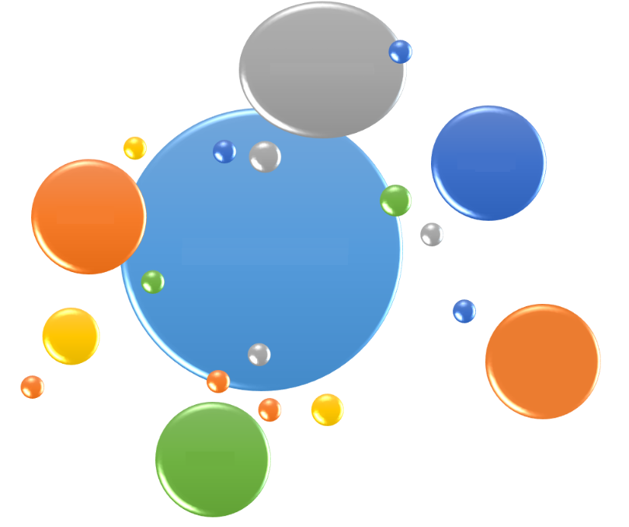
Data For All - Search Analytics
Data For All is a search platform / portal with multiple ‘static’ documents and ‘dynamic’ datasets in Power BI
Datasets entails attitude data from Kantar Media and Spent data from KWP
DFA has been built on Azure, with their Data Factory to import data from Legacy platforms and also O365 and Power BI to visualise - it is already live with 30,000 users across Kantar
Current PoC will demonstrate below capabilities.
Straight Search - This is usual Bot scenario, where Bot will greet user and ask questions to narrow down user selection and search asset matching to requirement and present it back to user.
Assets & Profile based Recommendation Scenario – Bot recognizes user and retrieve profile of the user. Identify peers of users based on profile. Provide recommendations based on peer activities. Ex if user is marketing user in USA, it will recommend that similar users have been searching for xyz assets in last few days
History based Recommendation Scenario – If user has search history, Bot will retrieve user search history for previous 5 logins (lets say user has searched 5 assets), it will present a recommendation based on previous search results
Semantic Recommendation scenario - Bot recognizes user search key words (lets say user searched for Coke).Bot will provide semantic recommendation like in our example Pepsi (Pepsi being Coke competitor) or Coke Market share (Market share being semantic to Revenue) etc
Chat BoT
DAAS
Analytics-Recommend
Data for All
Search Analytics
V3 -5
Advanced
Algorithms
NLP

Slide 5
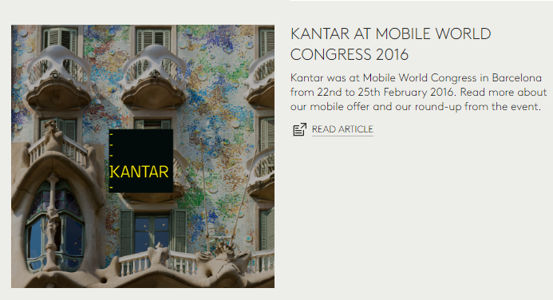
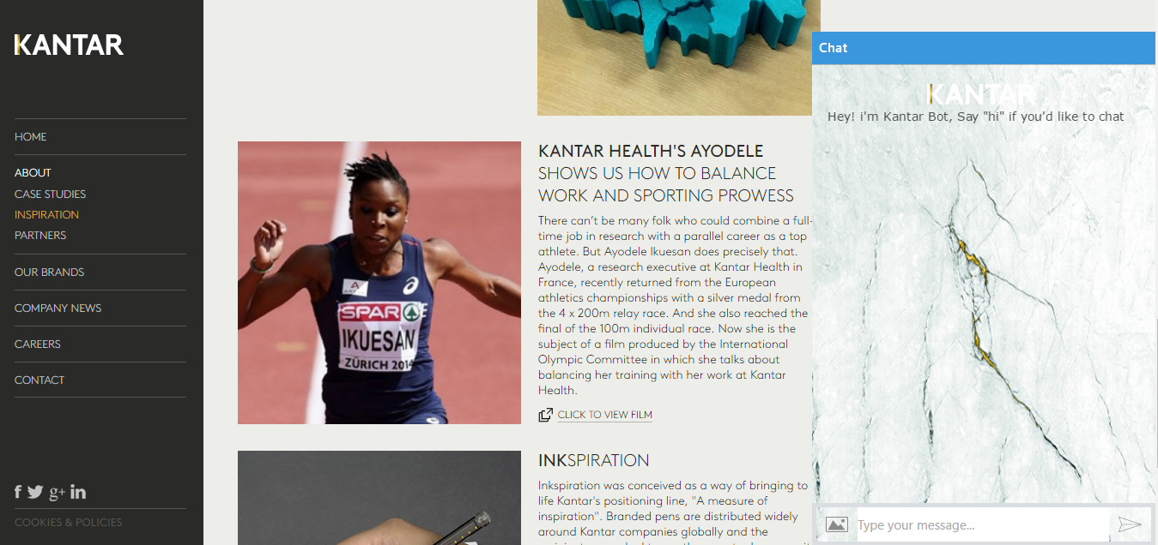
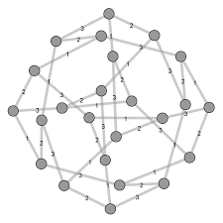
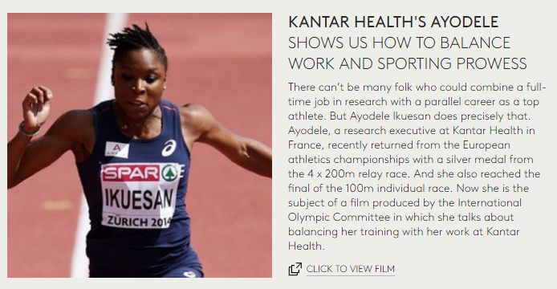
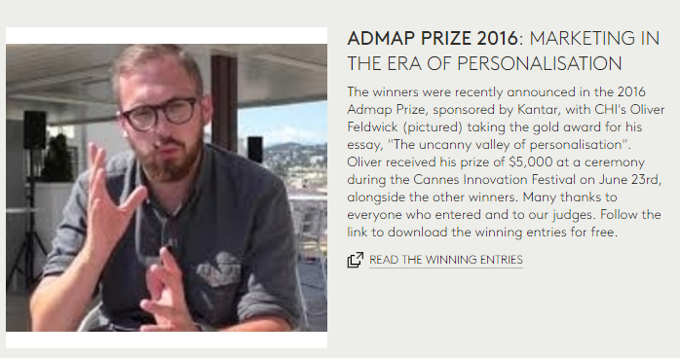
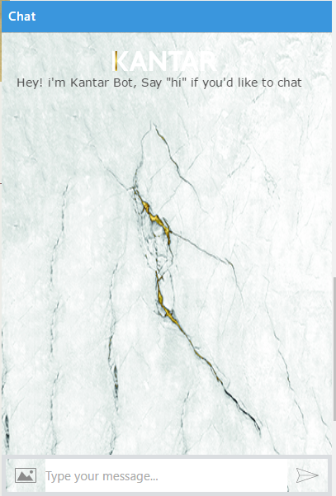
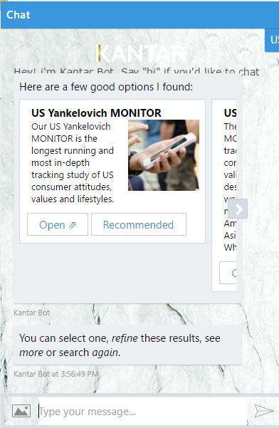

BOT Framework Overview
Data For All
Algorithms
Kantar BOT
Markov Chaing and Semantic Analysis
Activity Based Searches
Peer Recommendations

Slide 6





Proposed BOT Solution
Azure Data Factory
NLP (Power BI)
Azure Data Lake Store
Document Classifier
Power BI
Notebooks
Raw Data
Prepared Data (Unstructured)
Topic / Content Extractor
Interactive Analytics
Data
Prepared Data (Structured)
Data Analytics
Keyword finder
Web service
Data Preparation
Hello Kantar Bot
Hi Martin
Kantar bot
Coca cola in united kingdom
Logic
We have found
1. 20 Documents
2. 5 Power BI Dashboards (NLP)
3. 2 external links
Bot Connector
Lync / Custom Channel
Bot Builder SDK (Node.js + C#)

Slide 7
Data for BOT framework
Asset Based Data
Profile Data
Activity Data

Slide 8
Data Asset Visualization

Slide 9
Data Asset Visualization
Since the Data for All portal launch in July 2016, feedback from the User community has centred on lack of ability to access the most relevant data and assets we have available within the portal. The Users need a single viewpoint from which they can navigate through over 500 assets. This viewpoint should include brief introductions to assets with source operating brand clearly visible and filters for Sector, Market and expertise areas the data covers so that users are;
More informed on the products and services across Kantar
Able to identify points of collaboration in Client engagements
Able to identify the most relevant data available
Can self-navigate through the wealth of assets available
 | Variable 1 | Variable 2 | Relationship
1 | Data Asset | Sector | 1:N
2 | Data Asset | Country | 1:N
3 | Data Asset | Expertise | 1:N
4 | Data Asset | Data Type | 1:N
5 | Operating Brand | Data Asset | 1:N
6 | Operating Brand | Sector | 1:N
7 | Operating Brand | Country | 1:N
8 | Operating Brand | Expertise | 1:N
9 | Operating Brand | Data Type | 1:N
10 | Business Problem | Data Type | N:N

Slide 10
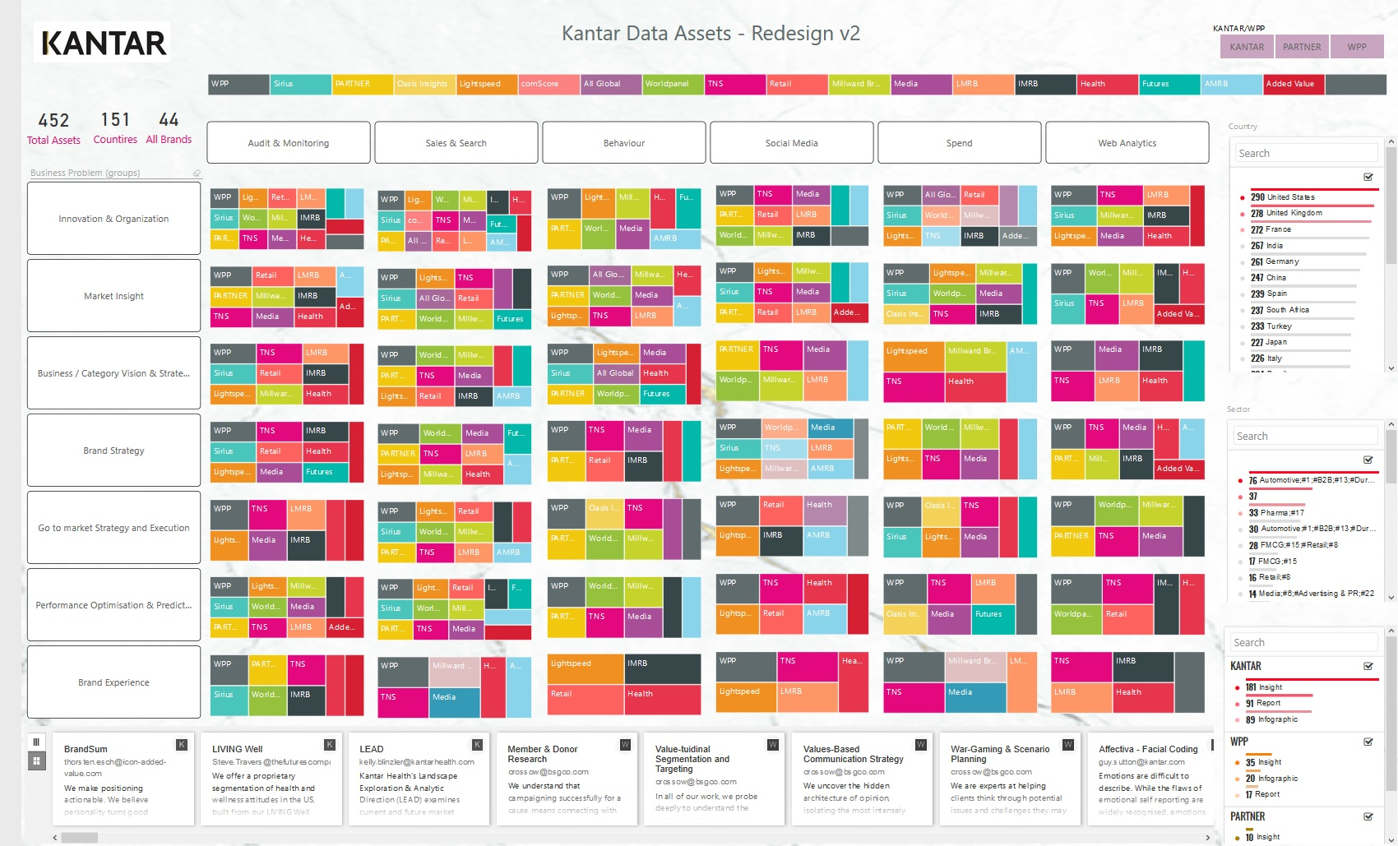
Data Asset Visualization – Power BI

Slide 11
Graph Analytics

Slide 12
Graph Analytics Overview
Build Graphs
Leverage Metadata Search Activity
Calculate Score or Degree for Assets
To build a Graph Model on Kantar Assets information based on its association with Country, Operating Brand and Expertise and build Degree or Score of prominence for each Asset
Graph Analytics for Kantar
Leverage Content Search Activity
Leverage association of Assets with all dimensions
Weightage for associations
Technologies – R Scripting and Power BI

Slide 13

Methodology / Process
Step 1
Step 2
Step 3
Node Creations
Edges or Link creations
R – Script and Power BI
R Script to
process Nodes and Links to create a Graph Object
Calculate Degree or Score for each Asset
Expose out Graph on Power BI
Define all nodes as below
Assets
Countries
Operating Brands
Expertise
Transform data to create
Relations between Nodes
Ex Asset A-784 is linked to countries C1, C2, C3

Slide 14
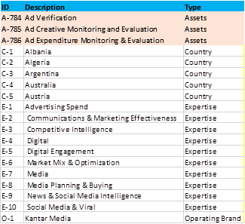
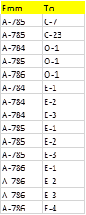
Data Preparation (Nodes and Links creation)
Nodes
Asset Catalogue
Links

Slide 15
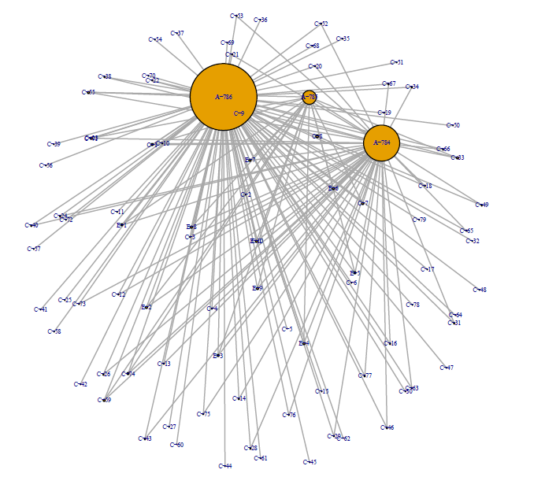
Graph and Degree/Score for Asset
Asset A-796 (Ad Expenditure Monitoring & Evaluation) is more prioritized as it has more association degrees with various dimensions

Slide 16
Kantar - Master Data Management

Slide 17
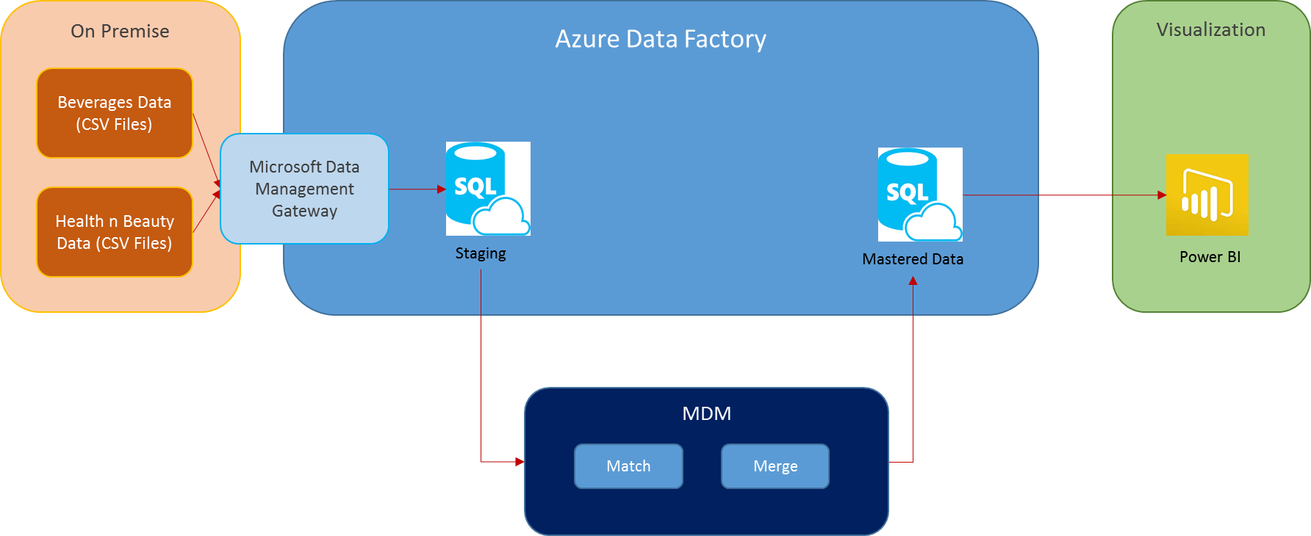
MDM process flow

Slide 18
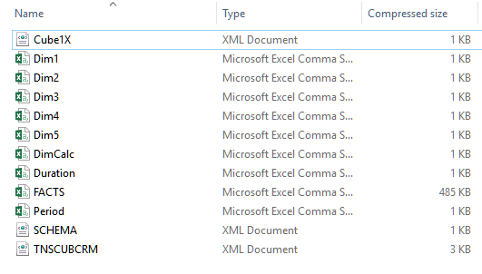
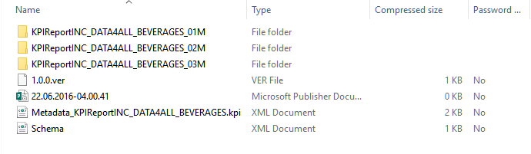
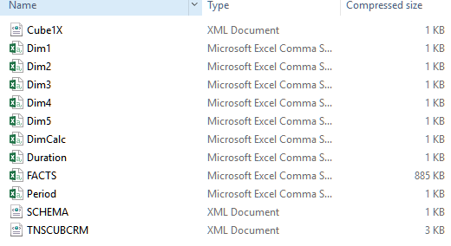
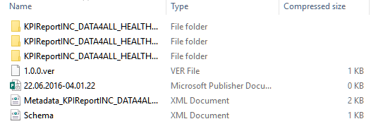
Raw data

Slide 19
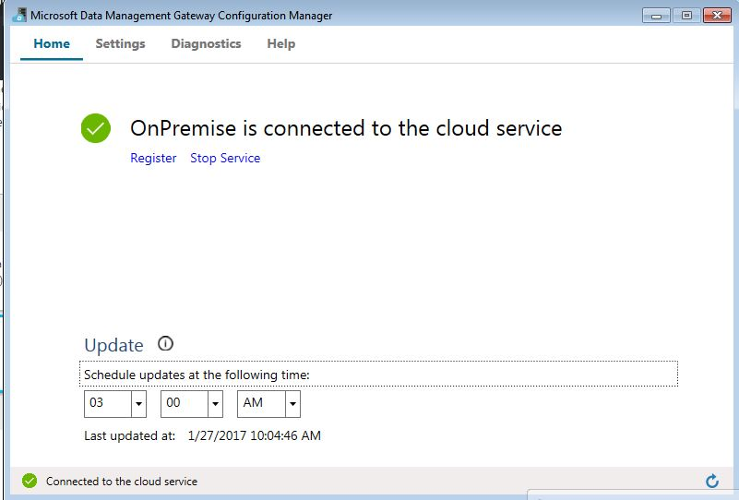
Data Management gateway configuration manager

Slide 20
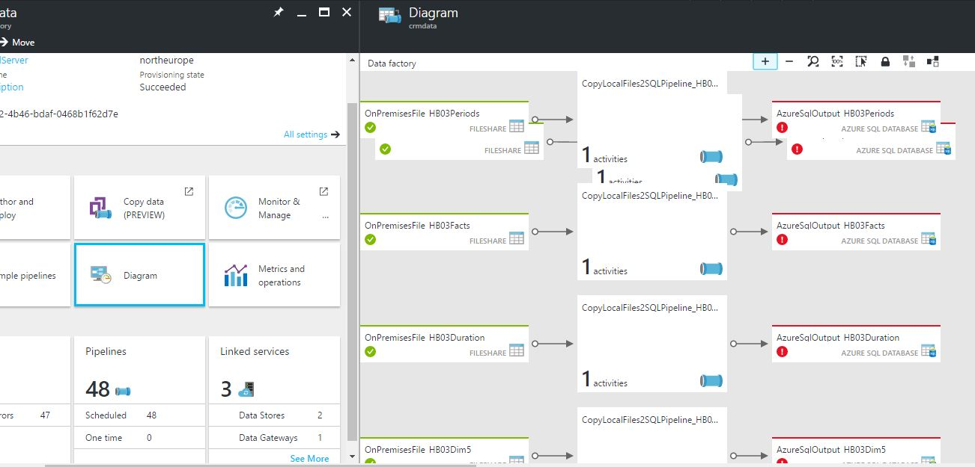
Azure data factory pipeline

Slide 21
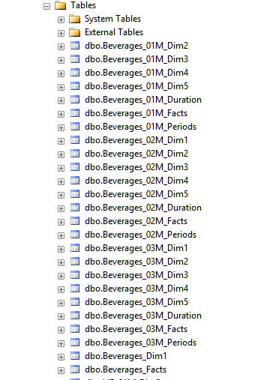
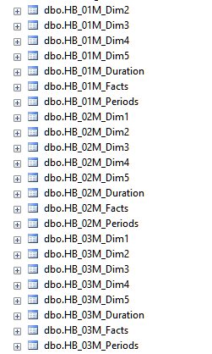
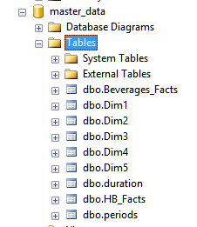
Match and merge
H&B Staging
Master Data – After Match & Merge
Beverages Staging

Slide 22
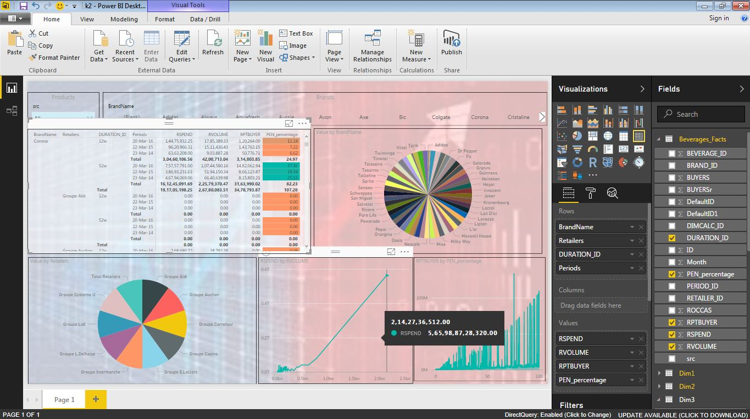
Power BI

Slide 24
Appendix

Slide 25
Data For All (Search Capabilities)
BASE
SEARCH
Portal
Creation
Indexing
Query Processing
Fielded Searching & Sorting
CONTEXTUAL SEARCH
Multiple-Index Searching
Simultaneous Index Update
Meta Search
Faceting, Highlighting & Grouping
Ranked Searching
Text Extraction
SEARCH
BOT
Bot Framework
Chat Bot –Static
Chat Bot –Dynamic
BoT Voice Over
SEARCH
RECOMMENDATIONS
DFA Suggest
Instant Search
Spell-Check
SEARCH
VISUALIZATION
Visual Intelligent Search Solutions
Personalization
Layout Cockpit
Workflow Management UI
On Demand Visualization
SEARCH
ANALYTICS
Machine Learning
Text Analytics
Intelligent Sense
Matrix Factorization
Design of Experiments
SEARCH
ALGOS
Markov Chaing and Semantic Analysis
Latent Dirichlet Allocation
Word Sense based representation & categorization

Slide 26
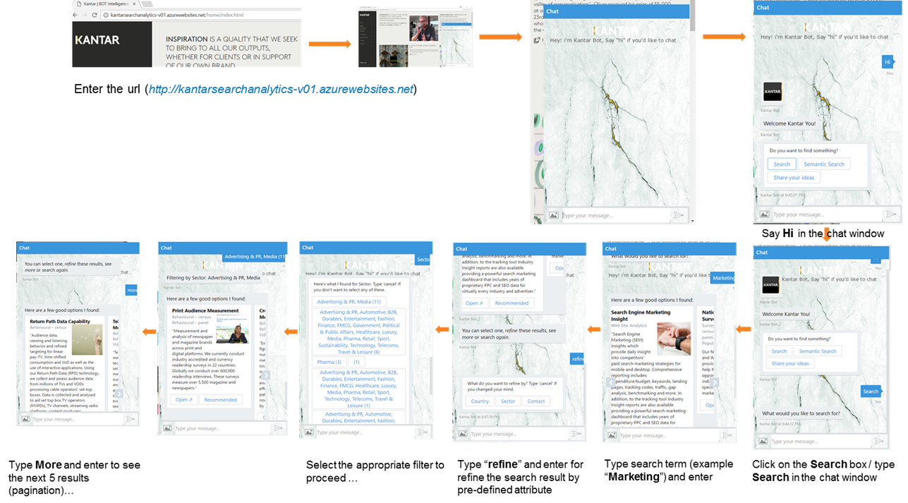
BOT framework - Demo Flow

Slide 27
Data Asset Visualization - The Kantar offer
Offer Development Steering Committee Update – Sep ‘16
BUSINESS / CATEGORY / VISION & STRATEGY
BRAND STRATEGY
INNOVATION
BRAND EXPERIENCE
GO TO MARKET STRATEGY & EXECUTION
ORGANIZATION
PERFORMANCE OPTIMIZATION & PREDICTION
Win with Shoppers
and Customers
Engage the organization and build capability
Measure KPI’s impact and maximize ROI
Where to play
What to stand for
How to disrupt and renew
Engage the consumer
Macro trends & foresight
Public Opinion
Market & competition analysis
Corporate strategy
Category & portfolio strategy
Segmentation
Emerging, developing & mature markets
Trends
Cultural insight & application
Government Policy and Program development
Brand positioning
Brand architecture
Brand value proposition
Brand Reputation
Trends
Cultural insight & application
Public behavior change
Opportunity identification, sizing and prioritization
Ideation & concept design
Proposition validation & optimization
Product & Service testing & user experience
Consumer journey
Pricing strategy
Touchpoint planning
Audience targeting
Communications planning & creative development
Digital Marketing
Packaging
Retail & channel insights & strategy
Distribution & route to market strategy
Shopper insights & path to purchase
Touchpoint maximization
POS optimization
Sales planning
Pricing strategy
Trade investment optimization
E-Commerce
Salesforce Automation
Organizational transformation & embedding
Skills & competencies development / training
Employee experience
ROI measurement, program evaluation & analytics
Tracking & optimization consultancy
Behaviour
Sales
Brand
Media
Content/ creative
Retail execution
Trust & Reputation
Customer experience

Slide 28
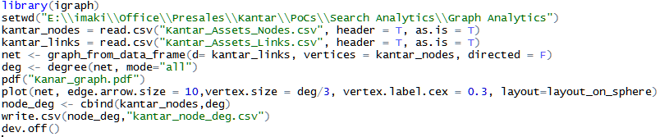
Graph Analytics - Script and Files

Slide 29
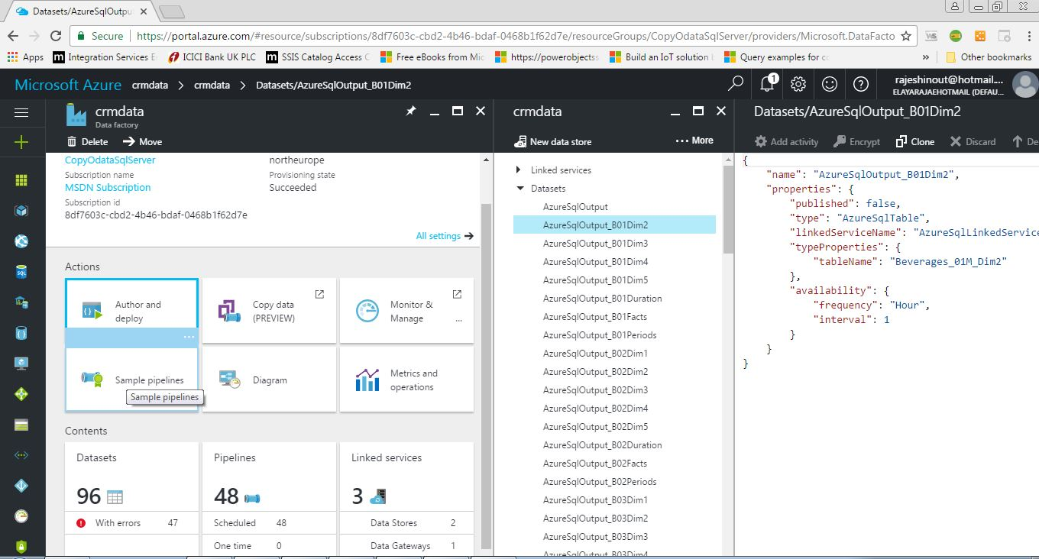
Master Data Management - Azure data factory

